Slide 1
Log Integrity Monitoring System
Sumaiya Arshad - 231279
Marryum Afzaal - 233100

Slide 2
PROBLEM STATEMENT
  Log files are frequently targeted during cyber attacks
  Traditional monitoring tools:
  Are complex to configure
  Require centralized infrastructure
  Lack real-time alerts
  Need: A simple yet effective log integrity monitoring system

Slide 3
PROJECT OBJECTIVE
  Monitor critical system and user directories
  Detect file creation, modification, and deletion
  Verify file integrity using cryptographic hashing
  Identify security events from log files
  Provide a professional GUI
  Generate detailed security reports

Slide 4
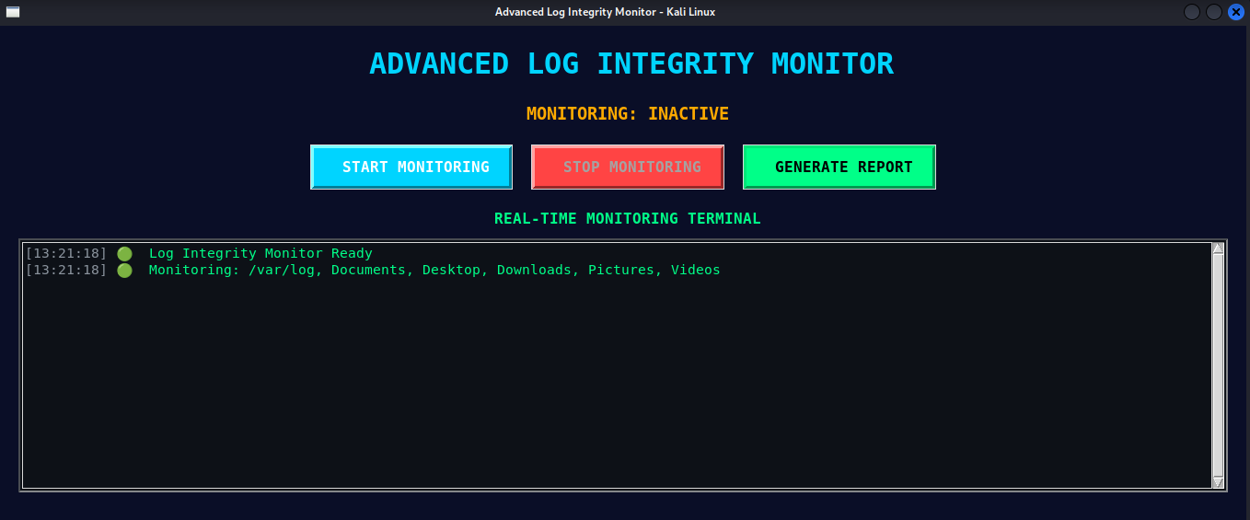
SYSTEM ARCHITECTURE
Modules:
  GUI
  Monitor Engine
  Hash Engine
  Database
  Report Generator
Project Scope
Monitored Locations:
  /var/log
  User directories (Documents, Desktop, Downloads)
  /etc (configuration files)
  /var/www (web server)

Slide 5
TECHNOLOGIES USED
  Python 3 – Core logic
  Tkinter – Graphical User Interface
  Watchdog – File system monitoring
  SQLite – Event & hash storage
  SHA-256 – Integrity verification
  Kali Linux – Security OS

Slide 6
WORKING METHODOLOGY
  User starts monitoring
  File system events detected
  Hash of file is generated
  Hash compared with baseline
  Security analysis performed
  Alerts shown in GUI
  Events stored in database

Slide 7
FILE INTEGRITY VERIFICATION
Security Events Detected
  Failed login attempts
  Authentication failures
  Sudo command usage
  Unauthorized log file deletion
  Suspicious file modifications
Hash-Based Integrity Monitoring
  SHA-256 hash generated for each file
  Hash stored in SQLite database
  On modification:
    New hash generated
    Compared with stored hash
  Mismatch = Integrity violation

Slide 8
DATABASE & LOGGING
  SQLite database used
  Stores:
  Timestamp
  Event type
  File path
  Severity level
  Ensures persistence of events
  Useful for forensic analysis

Slide 9
  Requires root privileges
  No remote alerting (email/SMS)
  GUI-based (local system only)
  Large files skipped for performance
LIMITATIONS

Slide 10
FUTURE ENHANCEMENTS
  Email / Telegram alerts
  Cloud-based log storage
  Machine learning anomaly detection
  Dashboard analytics
  Role-based access control

Slide 11
CONCLUSION
  Successfully implemented a real-time log integrity monitor
  Enhances system security visibility
  Useful for cybersecurity labs & forensic analysis
  Lightweight and user-friendly solution

Slide 12
Thank You

